Slide 1
P
O
G
O
HOTEL BOOKING MANAGEMENT SYSTEM

Slide 2
INTRODUCTION
Online Hotel bookings are a popular method for booking hotel rooms. Travelers can book rooms on a computer by using online security to protect their privacy and financial information And by using several online travel agents to compare prices and facilities at different hotels. This process is completely hassle free. It provides more secure, easy and 24/7 booking facilities.
I

Slide 3
MODULES
There are following eight modules in the project:
Account( log in or sign up)
Profile management and booking history( updating personal details and booking history)
Searching hotels (Based on city or area)
Booking rooms( With desirable filters goals)
Payment and acknowledgement (online)
Cancellation of booking
Forgot password
Change password

Slide 4
Module: account
In this module login webpage and signed up their page are created. Login is for accessing existing account and sign up is for creating new account.
2. Modules: profile management and booking history
This module comprises profile page and booking history page. Profile page renders all the personal details of the user and option to modify these details. Similarly, booking history page shows all the past booking placed by the user along with thier status either successful or cancelled. This page also provides the cancellation of the booking for future check-ins.
3. Module: searching hotels
In this module there is a page that provides searching button to search hotels after selecting location of the hotel by selecting state, city and area and check in date and check out date for booking purpose.
4. Module: booking rooms
This module has three pages . first page shows the list of hotels with the desired filter goals. Second page shows the information about the services and facilities provided by the selected hotel and third page for confirmed booking if user wants to book that hotel. this page also takes input of room type , number of rooms an number of guests.
5.Module:payment and acknowledgement
This module comprises online payment page and payment status acknowledgement page. Payment status will be either successful or unsuccessful.
6. Module: cancellation of cooking
In this module there are two pages. First page confirms the cancellation of previous booking and also takes the input of user's bank account details to transfer the refund. Second page is the acknowledgement page that shows the status of cancellation,
7. Module: forgot password
This module has three pages. First page takes the input of email ID that must be same as the registered email ID. Second page takes input of OTP that has already been sent to the email ID provided by the user at the previous page. Third page is for setting new password .
8. Module: change password
This module contains a page to change the password.

Slide 5
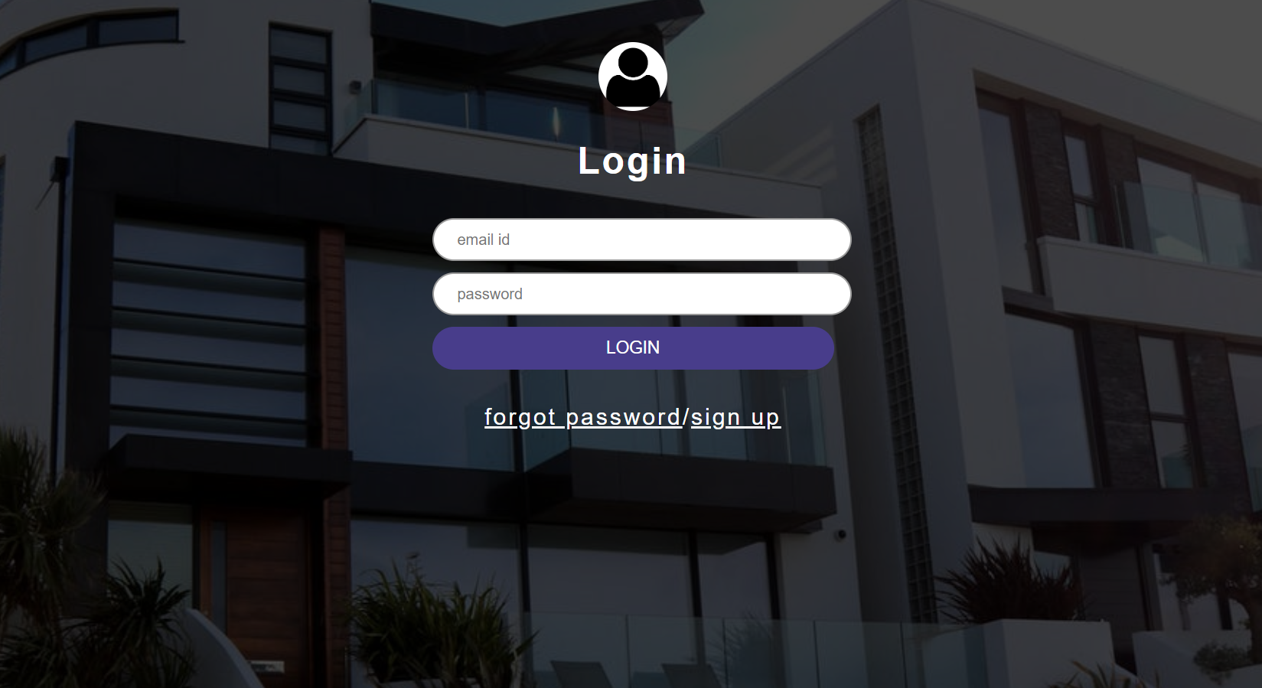

Slide 6
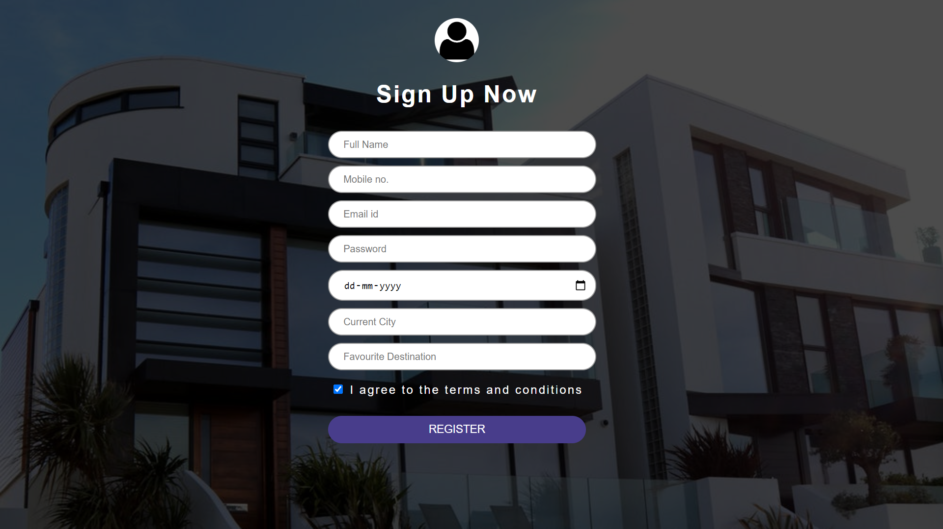

Slide 7
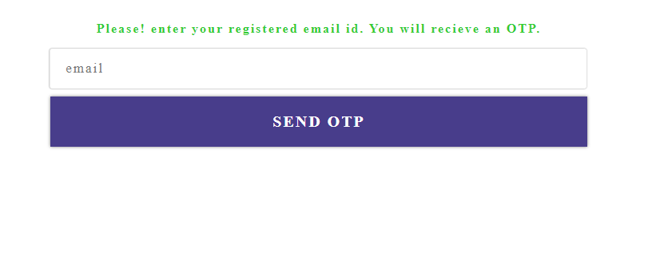

Slide 8
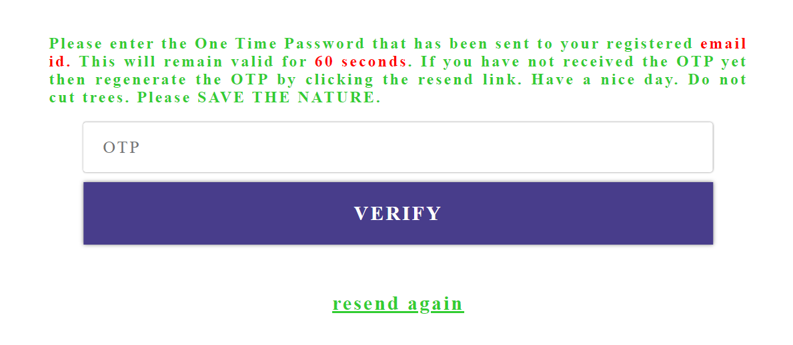

Slide 9
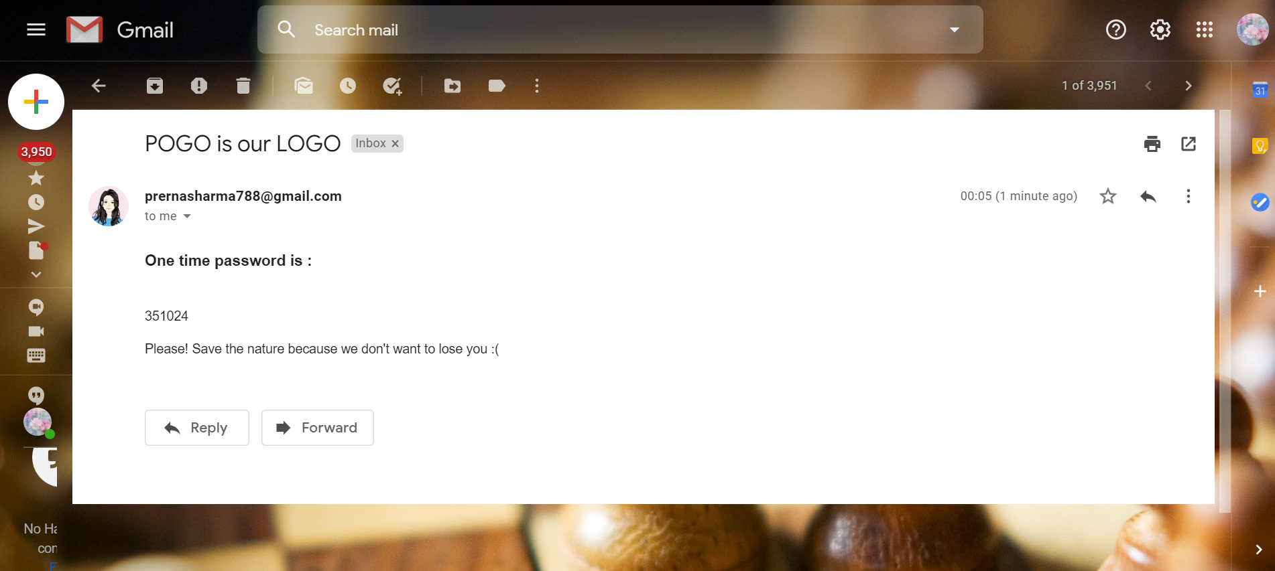

Slide 10
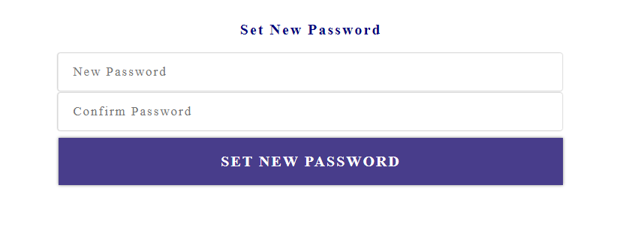

Slide 11
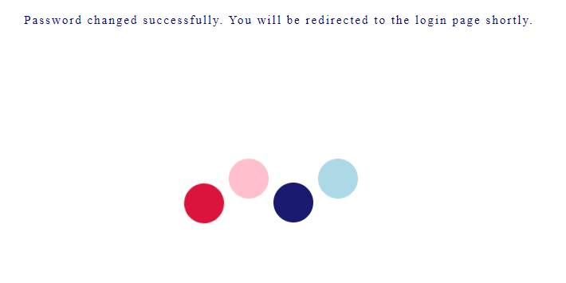

Slide 12
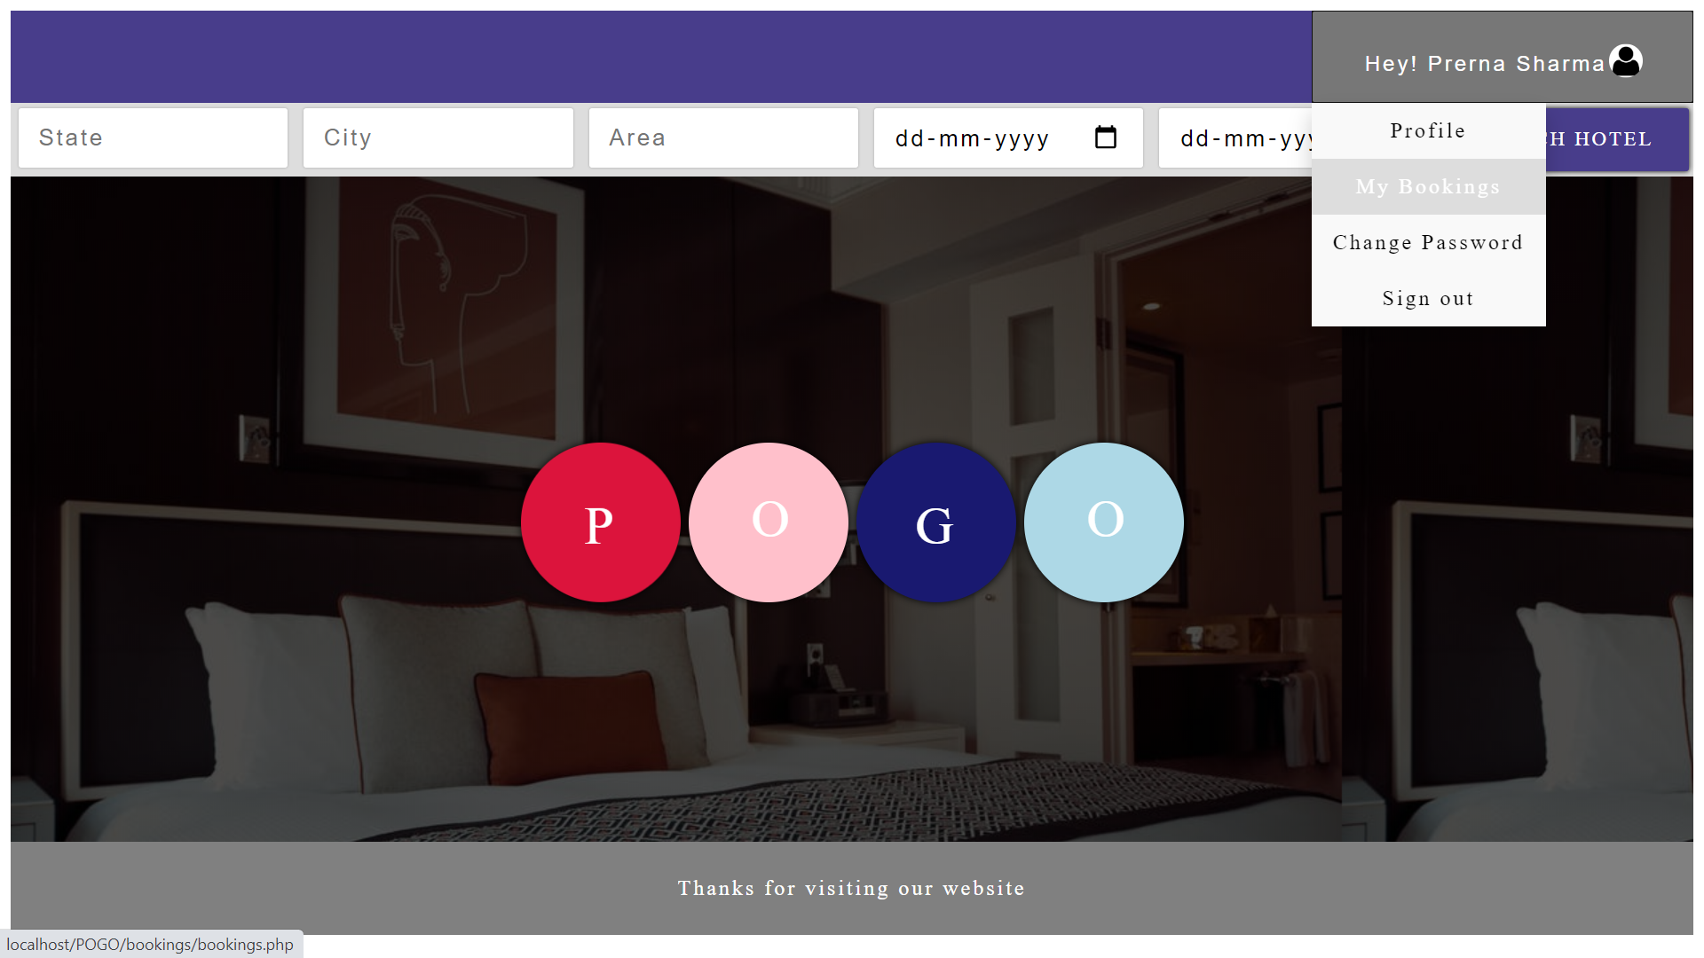

Slide 13
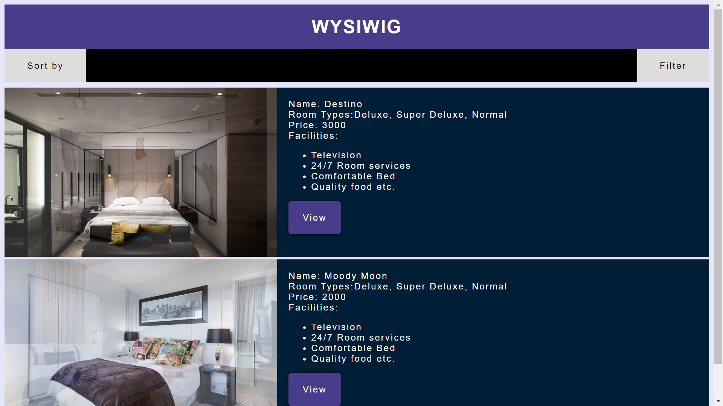

Slide 14
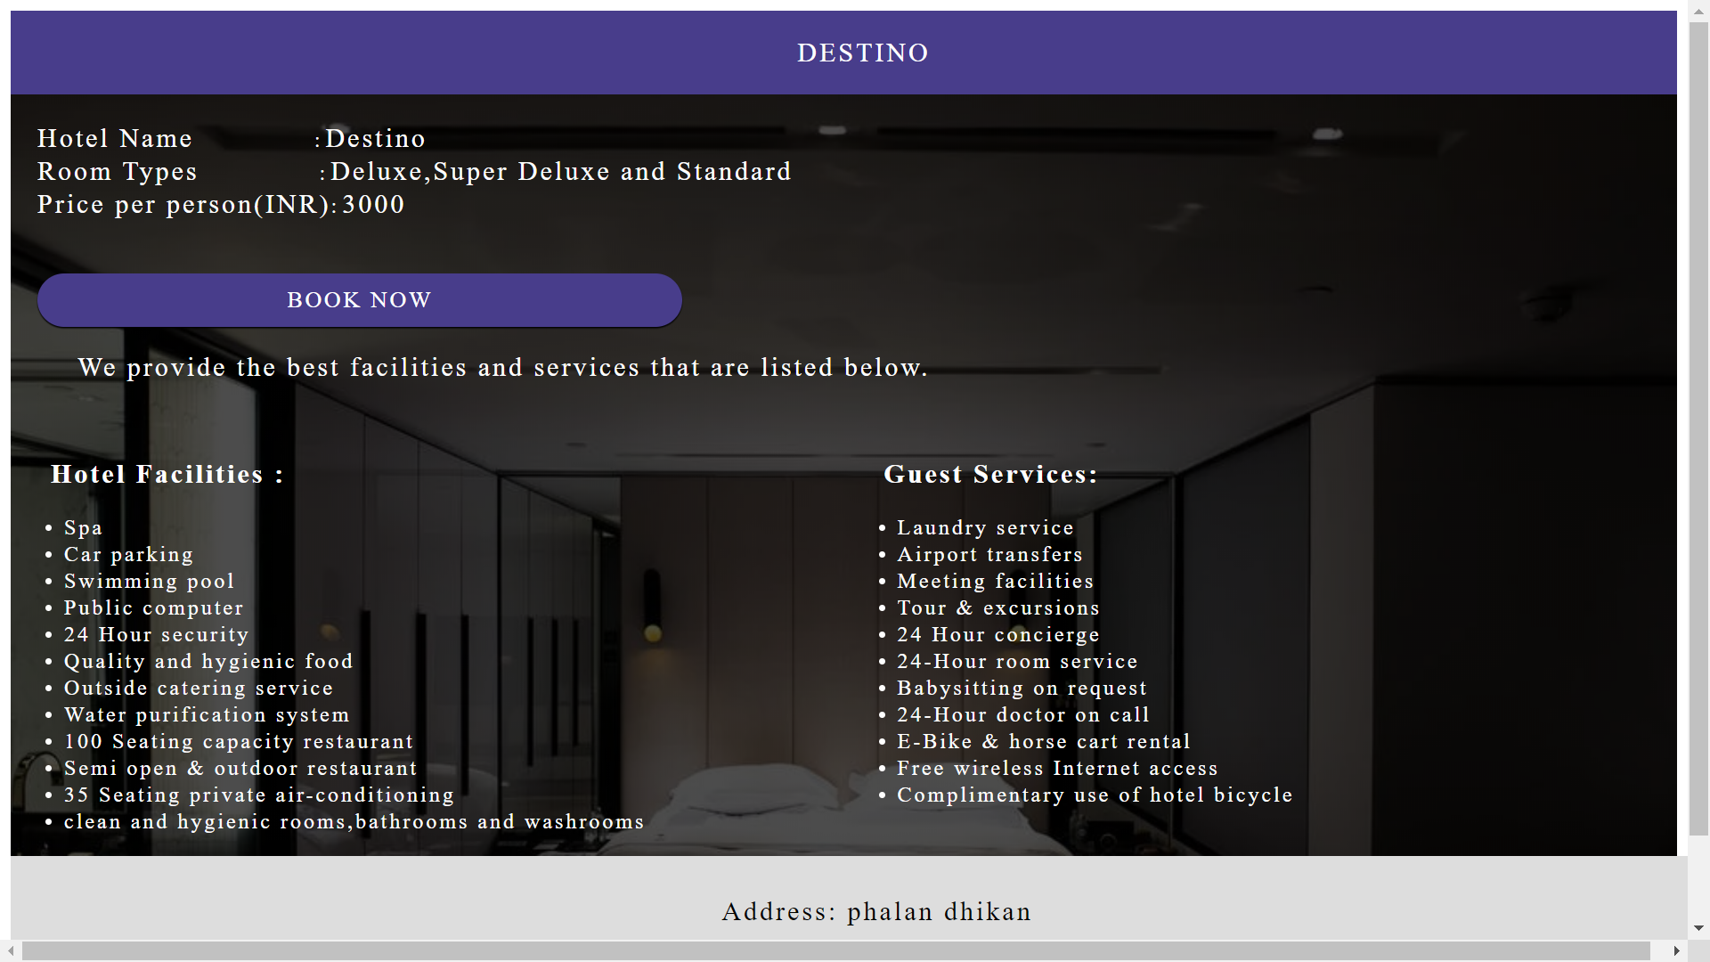

Slide 15
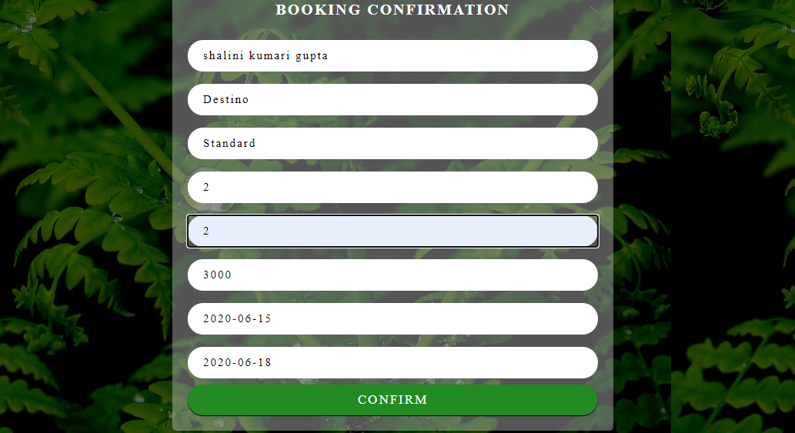

Slide 16
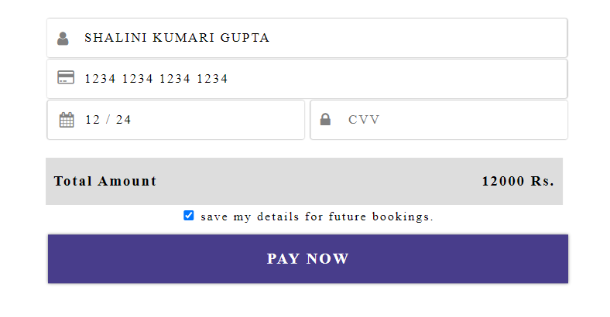

Slide 17
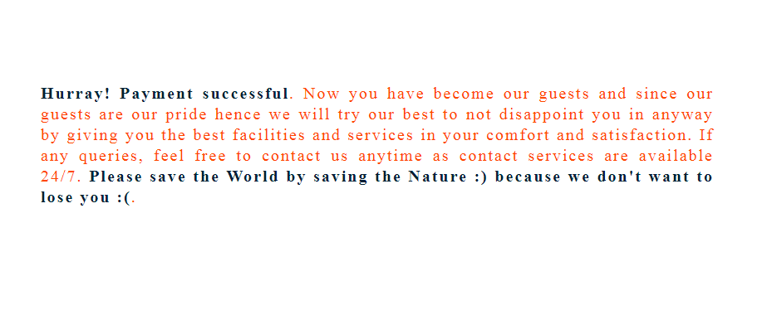

Slide 18
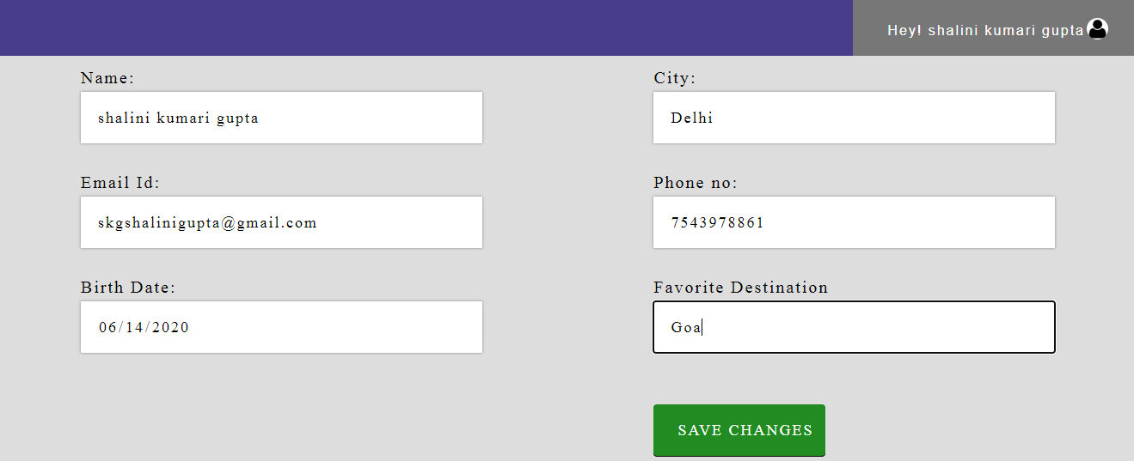

Slide 19
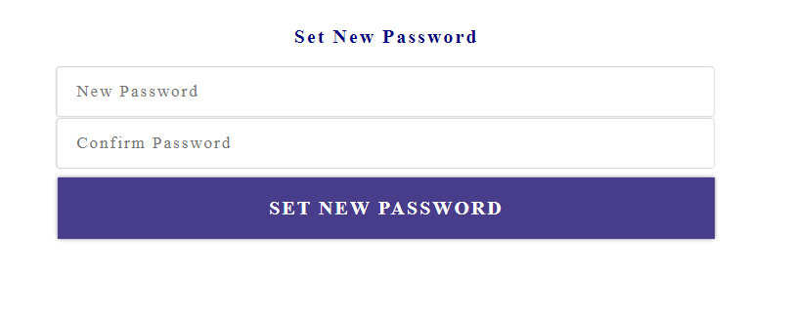

Slide 20
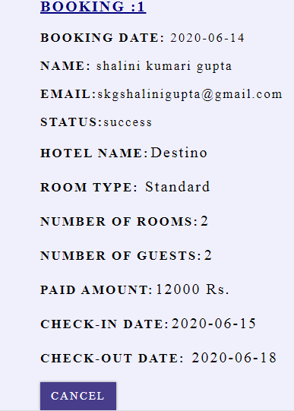

Slide 21
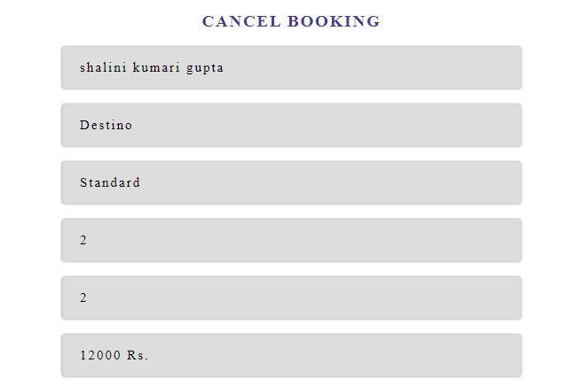
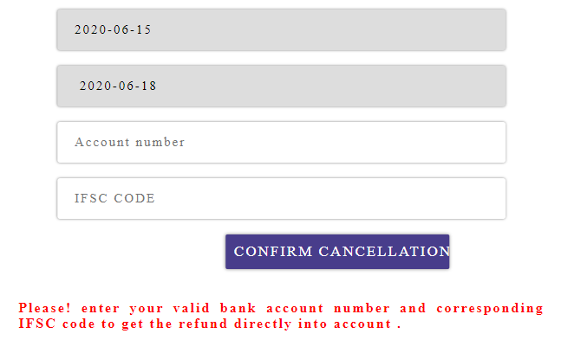

Slide 22
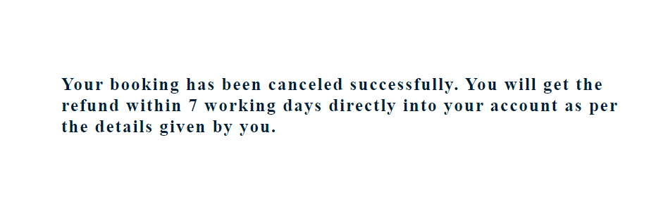

Slide 23
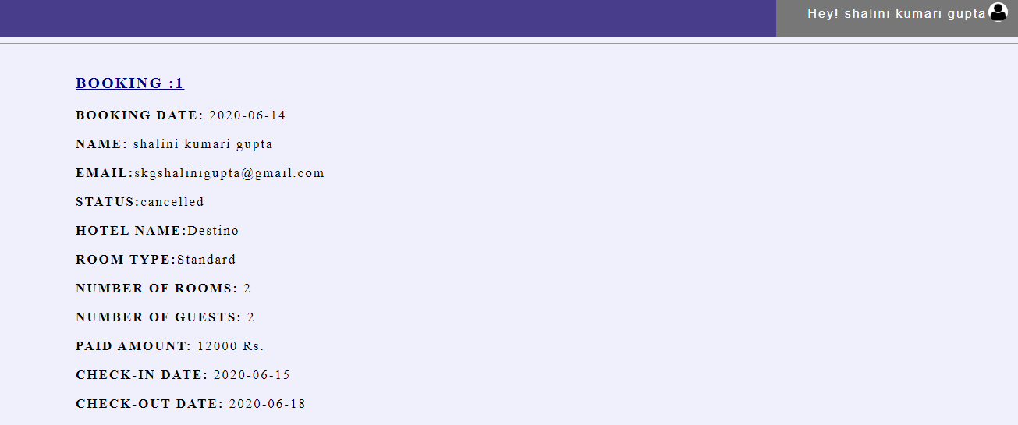

Slide 24
THE END
Submitted by,
Bhagvati Kaiwartya
Prerna Sharma
Shalini Kumari Gupta
Rajsabi Surya

